Slide 1

Module 3 Learning Presentation: Modeling Multi-Table Data Relationships
Scott Person

Slide 2
concepts
tables
table relationships
joins
primary and foreign keys
star schema versus snowflake schema
the meaning of "fact table" and "dimension table" in a star schema

Slide 3
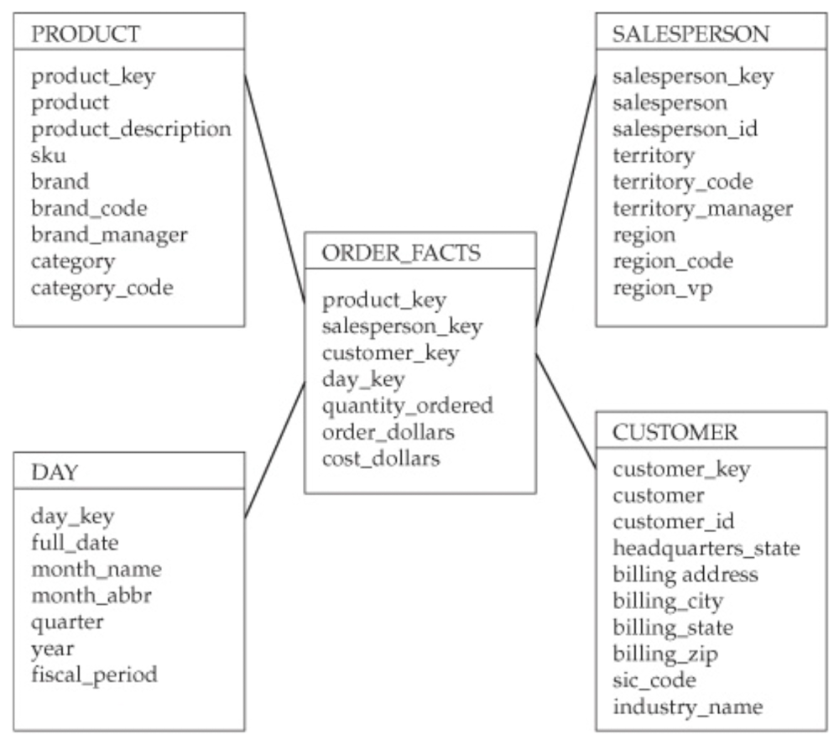
Star Schema
Starting with the end
Simple, elegant, efficient
Fact table one join away from each dimension table
Primary advantage: clear query path for analytical tools

Slide 4
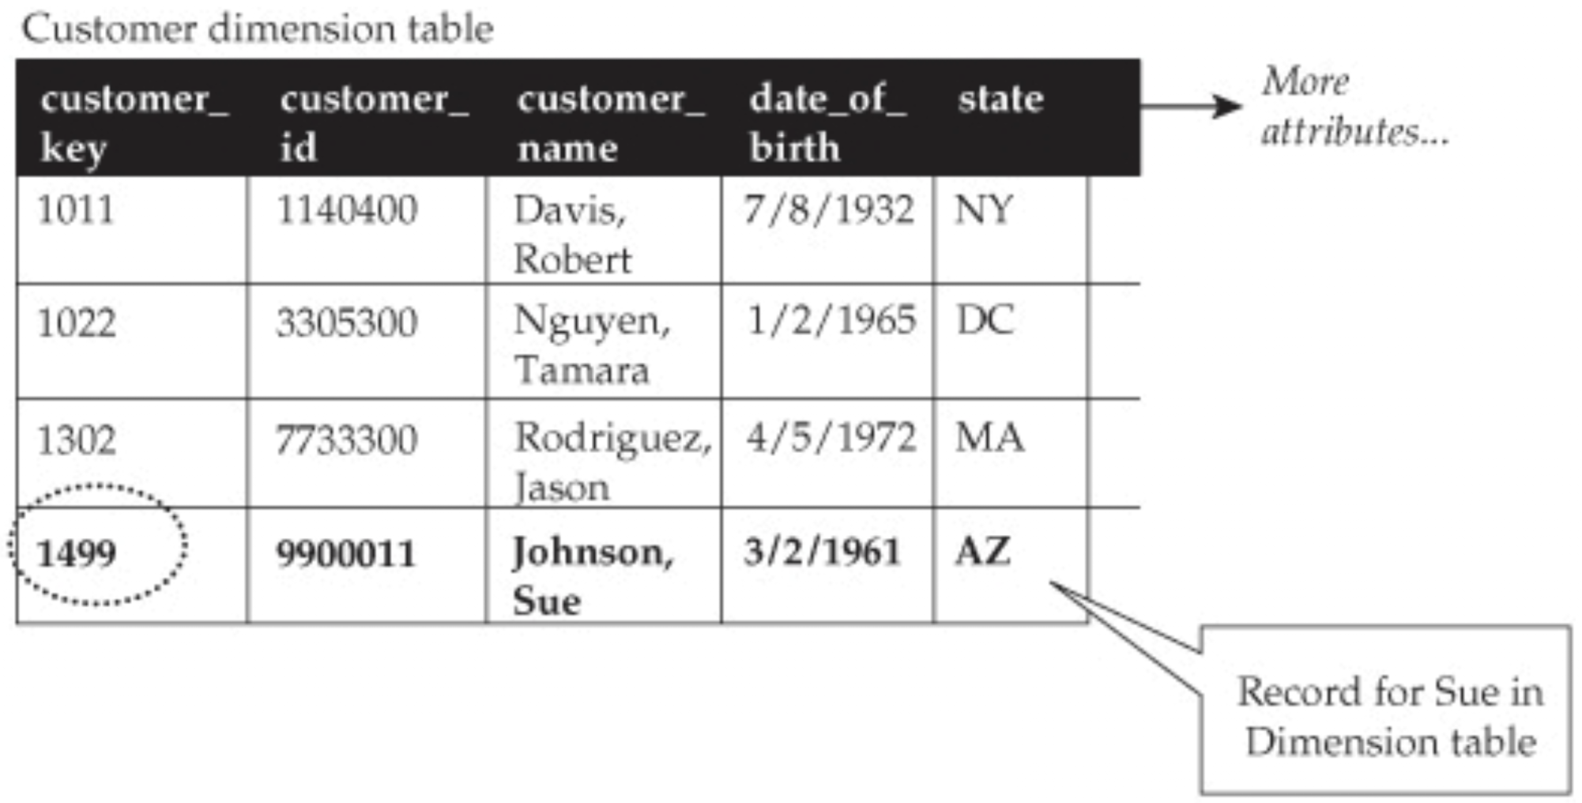
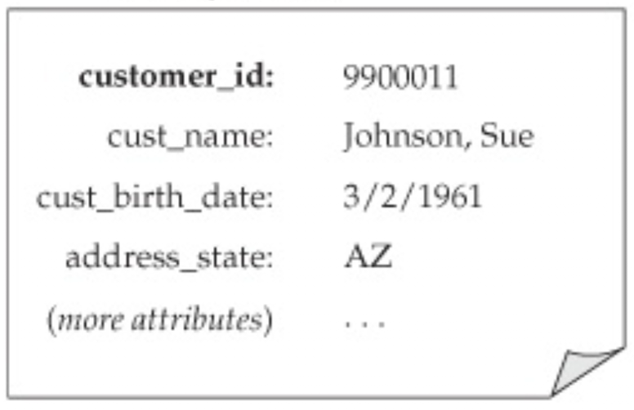
Tables
Organization of data
Columns and Rows
Primary Key

Slide 5
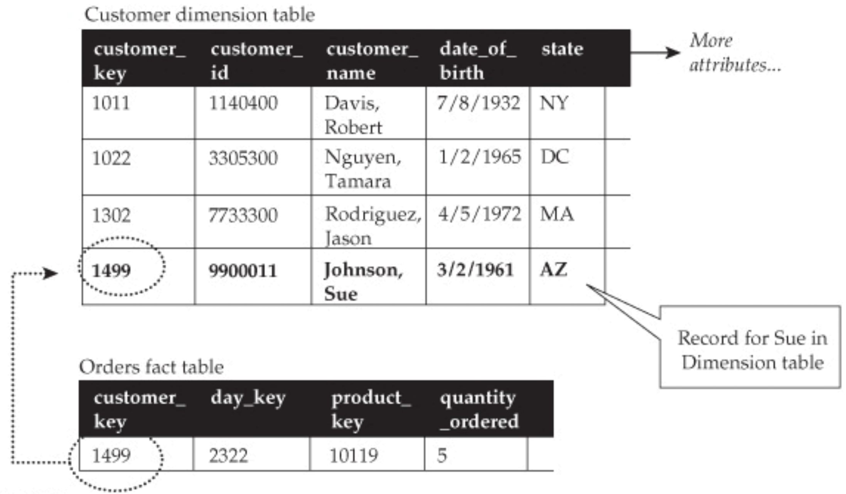
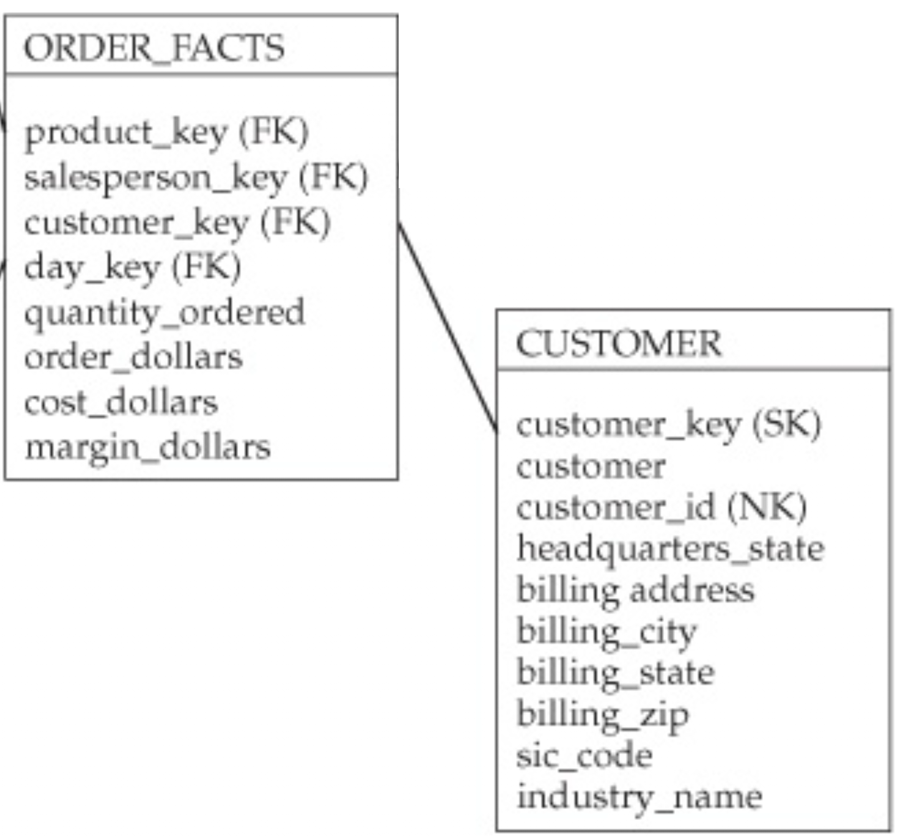
Table relationships, joins, keys
One to many cardinality
Joins made on the keys
Primary/Foreign key

Slide 6
Fact and dimension tables
Facts are events or Snapshots in time
Dimensions provide context to the facts
“By Rule” – Show me facts BY dimensions

Slide 7
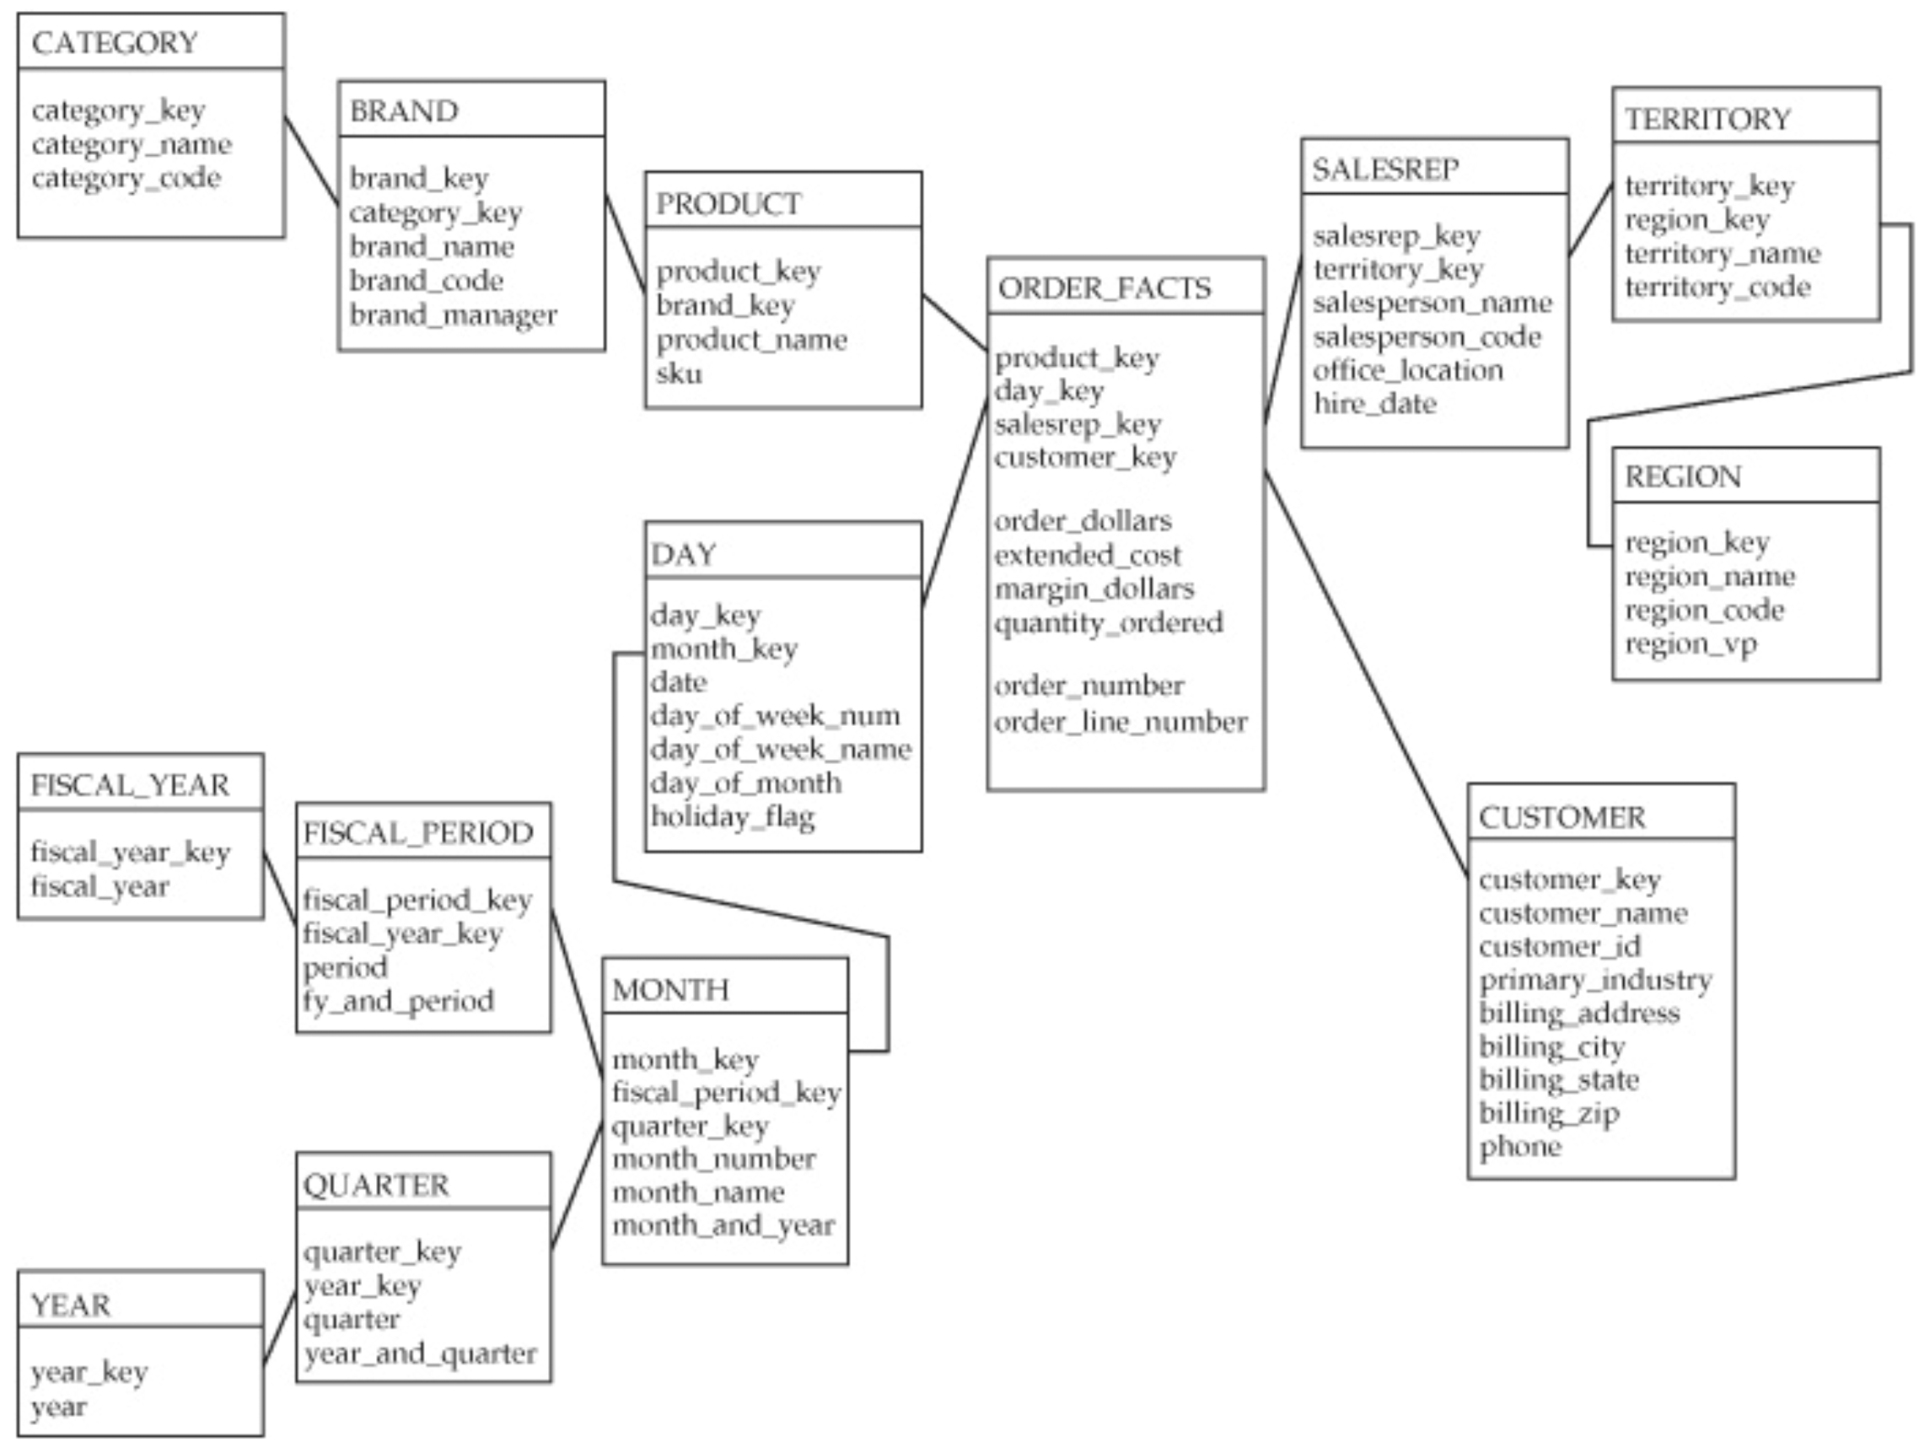
Star vs snowflake schemas
Snowflake schemas are seductive – nicely organized less data duplication
In practice they have few benefits
Increase data maintenance complexity
Slower performance

Slide 8
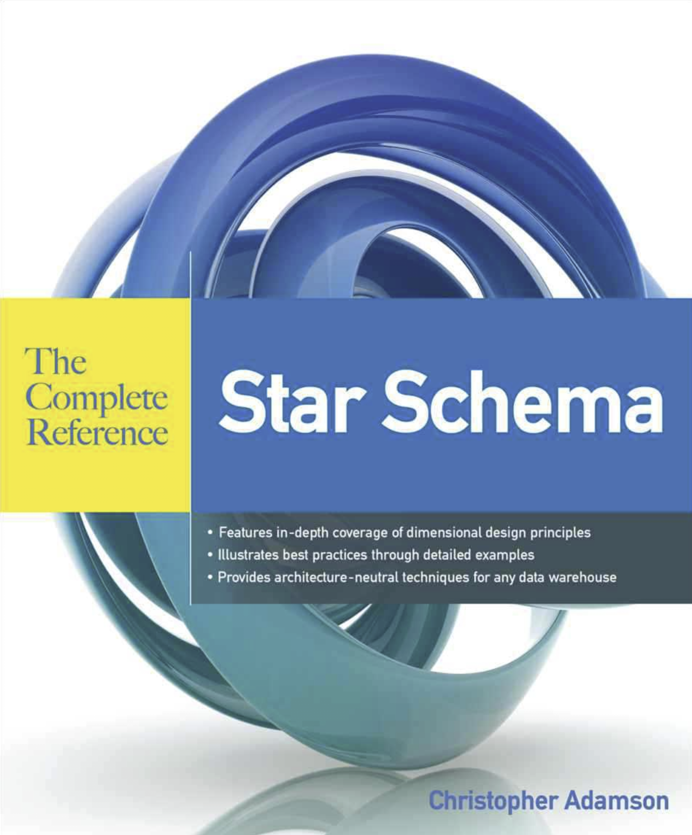
Citation
Adamson, C. (2010). Star schema: The complete reference. McGraw-Hill.

